Slide 1
A Framework for Benchmarking Entity-Annotation Systems
Source： WWW’13
Authors：Macro Cornolti, Paolo Ferragina
and Massimiliano
Advisor：Dr. Jia-Ling, Koh
Speaker：Wei Chang

Slide 2
Outline
Introduction
Entity Annotation Systems
Measurement
Experiment
Conclusion

Slide 3
Entity Annotation System
Knowledge Base

Slide 4
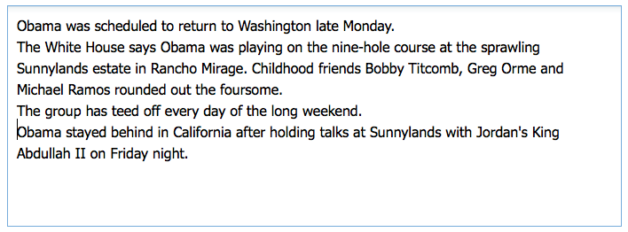
Example

Slide 5
Entity Annotation Systems
Many different entity annotation systems
But how to compare these systems?

Slide 6
Goal
Defining and implementing a framework for comparing in a complete, fair and meaningful way the entity annotation systems.

Slide 7
Outline
Introduction
Entity Annotation Systems
Measurement
Experiment
Conclusion

Slide 8
Entity Annotation Problems
Disambiguate to Wikipedia (D2W)
Annotate to Wikipedia (A2W)
Scored-annotate to Wikipedia (Sa2W)
Concepts to Wikipedia (C2W)
Scored concepts to Wikipedia (Sc2W)
Ranked-concepts to Wikipedia (Rc2W)

Slide 9
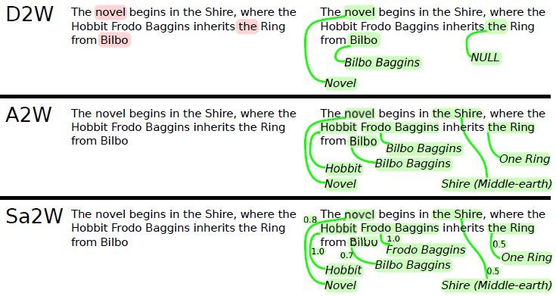
Entity Annotation Problems

Slide 10
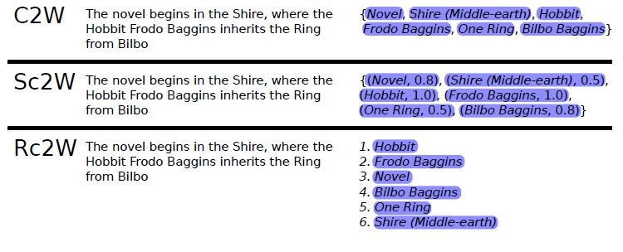
Entity Annotation Problems

Slide 11
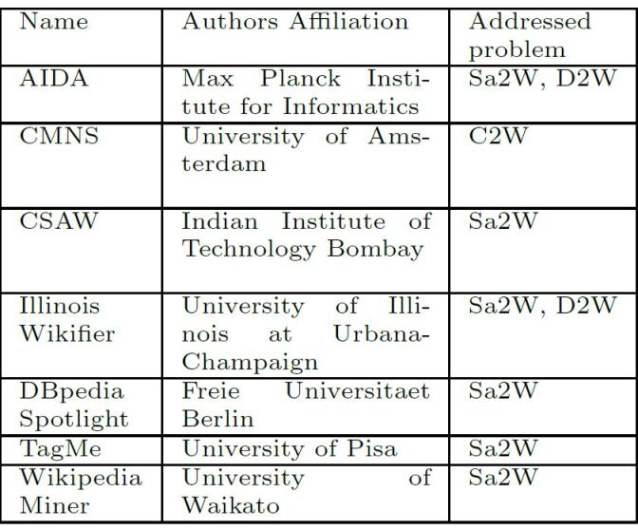
Entity Annotation Problems

Slide 12
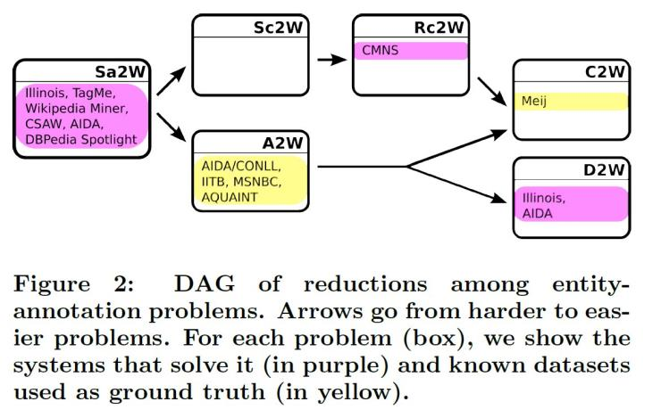
Entity Annotation Problems

Slide 13
Outline
Introduction
Entity Annotation Systems
Measurement
Experiment
Conclusion

Slide 14
Correct Match
President Barack Obama issues Iran ultimatum
Barack Obama
President Barack Obama issues Iran ultimatum
Barack Obama

Slide 15
Generalize Standard Evaluation
s: solution found by tested system
g: ground truth
M: binary relation M which specifies the notion of correct match"

Slide 16
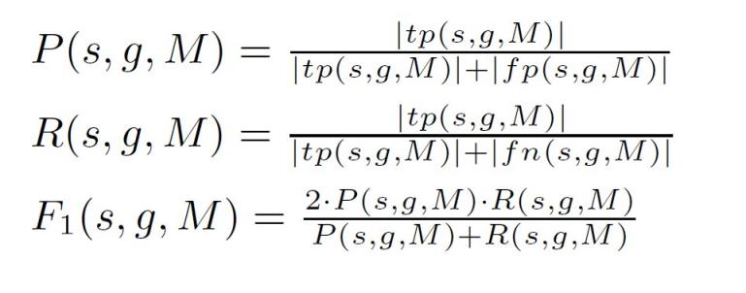
Precision, Recall & F1

Slide 17
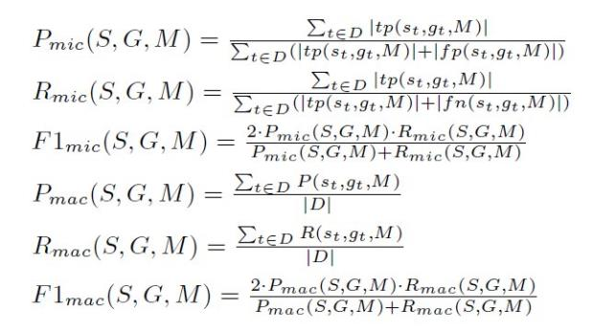
Macro and Micro
The macro- measures are the average of the corresponding
measure over each document in the dataset D, while the micro- measures take into account all annotations together thus giving more importance to documents with more annotations.

Slide 18
Correct Match
If the entity found by the system and the ground truth entity redirect to
the same entity, then set the correctness true.
The mention and the entity correct must be right(strong annotation match).
The mention overlap and the entity is right(weak annotation match).

Slide 19
Similarity between Systems

Slide 20
Outline
Introduction
Entity Annotation Systems
Measurement
Experiment
Conclusion

Slide 21
Dataset

Slide 22
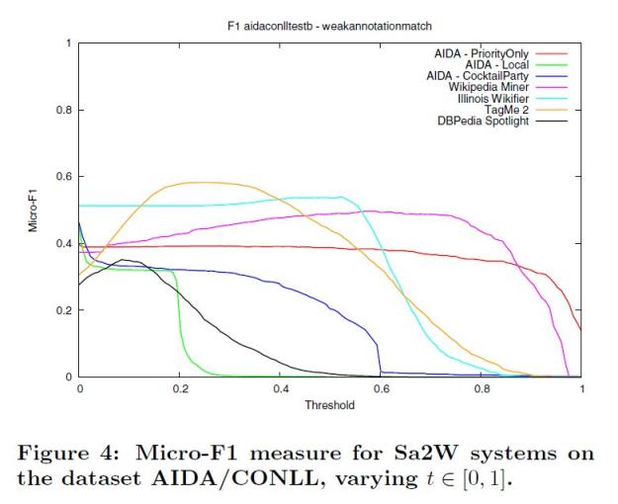
News

Slide 23
Similarity between Systems

Slide 24
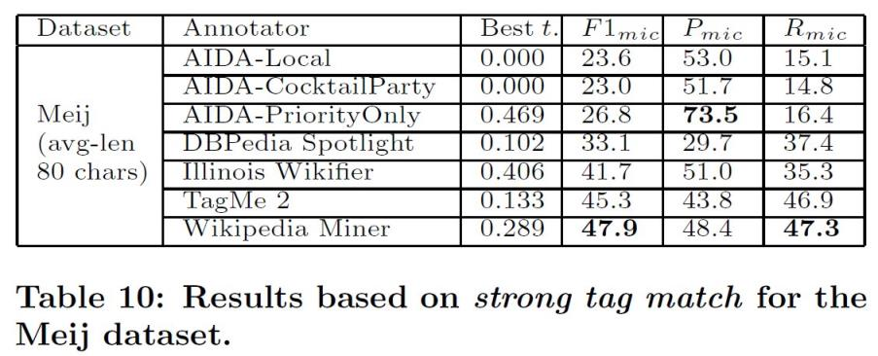
Tweet

Slide 25
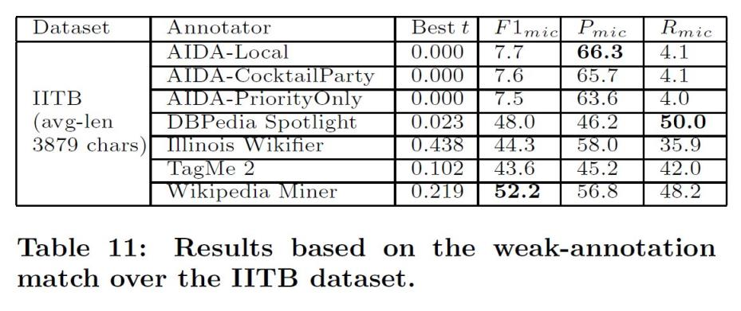
Web

Slide 26
Runtime Efficiency

Slide 27
Outline
Introduction
Entity Annotation Systems
Measurement
Experiment
Conclusion

Slide 28
Conclusion
We designed, implemented and tested a benchmarking framework to fairly and fully compare entity-annotation systems.
It is written in Java and it has been released to the public as open source code in https://github.com/marcocor/bat-framework .

